Slide 1
Agenda
Introducing Fern Software
Product lines:
  Core Banking – Abacus
  Loan Decisioning – Quantum AI
  Reporting Services – Financial Services Operations (FSO)
Industry Opinion about Fern Software
Why Choose Fern
Islamic Footprint & UK Opportunity
© Fern Software

Slide 2
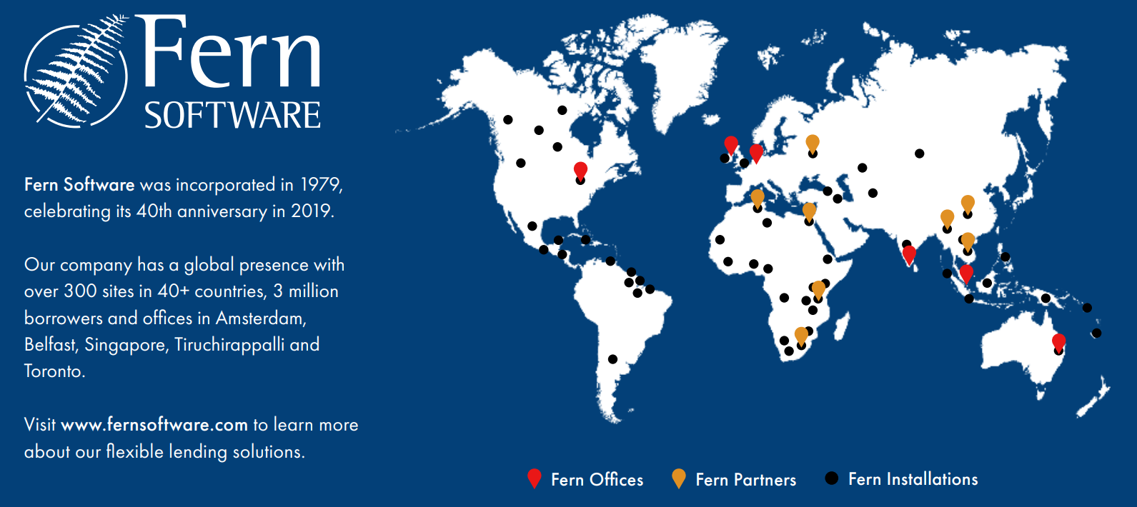
WHO WE ARE
Fern Software incorporated in 1979.
Our Company has a global presence with over 300 sites in 40+ countries, 6 million borrowers and offices in Amsterdam, Belfast, Singapore, Tiruchirappalli and Toronto.
Visit www.fernsoftware.com to learn more about our flexible lending solutions
© Fern Software

Slide 3
PRODUCT 1 — CORE BANKING
Abacus: Your Choice of Core Banking Deployment
Abacus is Fern’s core banking foundation, refined for over 47 years around the needs of ethical lenders. Every client gets the same depth of functionality — the only choice is how it’s deployed.
Abacus Hub
AbacusWeb
Cloud-native, built on Salesforce
Proven web-based core banking
Modern, API-first core banking for credit unions who want rapid deployment, elastic cloud scale, and a platform that evolves alongside Salesforce’s own roadmap.
Our established Microsoft SQL / .NET platform, enhanced every six months from direct field feedback — trusted across 40+ countries and every institution size.
CORE MODULES AVAILABLE OUT OF THE BOX
General Ledger
Savings & Term Deposits
Loan Origination
Credit Control
Collateral Management
Multi-Currency
CRM & Audit Trail
Branch Accounting
Batch Processing
Automated EOD
Internet & Mobile Banking
Open API Integration
© Fern Software

Slide 4




PRODUCT 2 — AI LOAN DECISIONING
Quantum AI: Faster, Fairer Lending Decisions
Fern’s award-winning AI decisioning engine evaluates loan applications in minutes rather than days — and works alongside any core banking system, not just Abacus.
Core-Agnostic by Design
92.7%
Deploys alongside any third-party core banking system — you don’t need to be running Abacus to benefit from Quantum AI.
Open Banking + Credit Bureau
prediction accuracy in automated loan underwriting
Connects directly to open banking feeds and credit bureau data to enrich every decision with real financial behaviour.
GDPR & Data-Sovereignty Safe
Award-Winning
Where required, Quantum AI can decision on fully anonymised, non-personal data — loan amount, term and score only — keeping you compliant wherever you operate.
World Bank Innovation Award & Product Innovation of the Year (Gold) — Global SME Finance Forum, 2024
Lower Delinquency, Lower Cost of Acquisition
Machine-learning models trained on your own historical data continuously improve risk prediction and collections targeting.
© Fern Software

Slide 5





PRODUCT 3 — REPORTING & COMPLIANCE
Financial Services Operations: Insight On Demand
Turn operational data into board-ready insight and regulator-ready evidence — without a spreadsheet in sight.
Live Dashboards
Built-In Report Writer
IFRS & Regulatory Compliance
Real-time dashboards for portfolio performance, collections and credit control, so leadership always has an up-to-date view.
Create and export custom reports to PDF, Excel, Word or RTF — no third-party BI tool required.
Standard and configurable reports aligned to IFRS and local regulatory reporting obligations, generated automatically.
Full Audit Trail
User-Defined Fields
Automated Distribution
Every transaction, override and user action is logged, giving auditors and regulators a complete, traceable history.
Track the metrics that matter to your institution by adding custom fields and folding them straight into your reporting.
Schedule standard reports for automatic generation and delivery to the people who need them, on the cadence you set.
© Fern Software

Slide 6

INDEPENDENTLY VERIFIED
Not Just Our Opinion — The Industry Agrees
CGAP
Accenture
USAID
Highest-scoring system reviewed — top marks (4/4) for functionality, ease of use and technical capability across 80 systems assessed.
Ranked #1 of 23 vendors in a Kenyan Government review across front office, back office, reporting and usability.
Fern client systems achieved the highest average data-quality score of all MFI systems studied.
RECENT AWARDS & RECOGNITION
✦ World Bank Innovation Award — 2024
✦ Best Banking Software Solution, Europe — 2022 Finalist
✦ Product Innovation of the Year (Gold), Global SME Finance Forum — 2024
✦ Credit Union Awards — Best Innovation Project
✦ Salesforce Innovation Award
Fern Software — Products & Services for Credit Unions
Fern Software

Slide 7
THE FERN DIFFERENCE
Why Choose Fern
Purpose-built for ethical lenders, not a retrofitted commercial bank system
47+ years of continuous investment — proven in the field, not just on paper
Independently top-rated by CGAP, Accenture and USAID
Award-winning AI decisioning that works with any core banking system
One global codebase — every client benefits from every improvement
No sales-driven culture — our team is almost entirely consulting, support and development staff
© Fern Software

Slide 8






Islamic Finance Across the World
Kingdom of Sauda Arabia
Kyrgyzstan
Tunisa
Afghanistan
Kingdom of Jordan
The Gambia
© Fern Software

